Slide 1
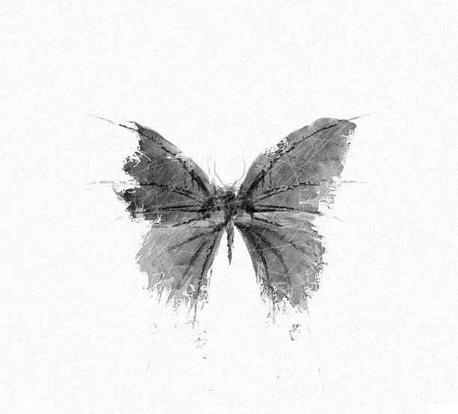
The butterfly effect
Muhammad Atir Tahir

Slide 2
The name of the effect, coined by Edward Lorenz

Slide 3
Theory
It has been said that something as small as the flutter of a butterfly’s wing can ultimately cause a typhoon halfway around the world.
Chinese P
Your acts are effecting someone somewhere

Slide 4
How the butterfly effect theory can improve your life?
Getting rid of a false belief
Tiny changes that can boost your social relations
Waking up thirty minutes earlier
If you do something, do it with the notion that you were supposed to do it, and if something has happened to you, it was supposed to happen to you.
There aren’t any coincidences or accidents.

Slide 5
if you sow a thought - you'll reap an act
if you sow an act- you'll reap a habit
if you sow a habit-you will reap a character
if you sow a character- you will reap a fate.

